Slide 1

Insuretech Predictions
28 Jan 2018
@hackathoncy #insurtech

Slide 2

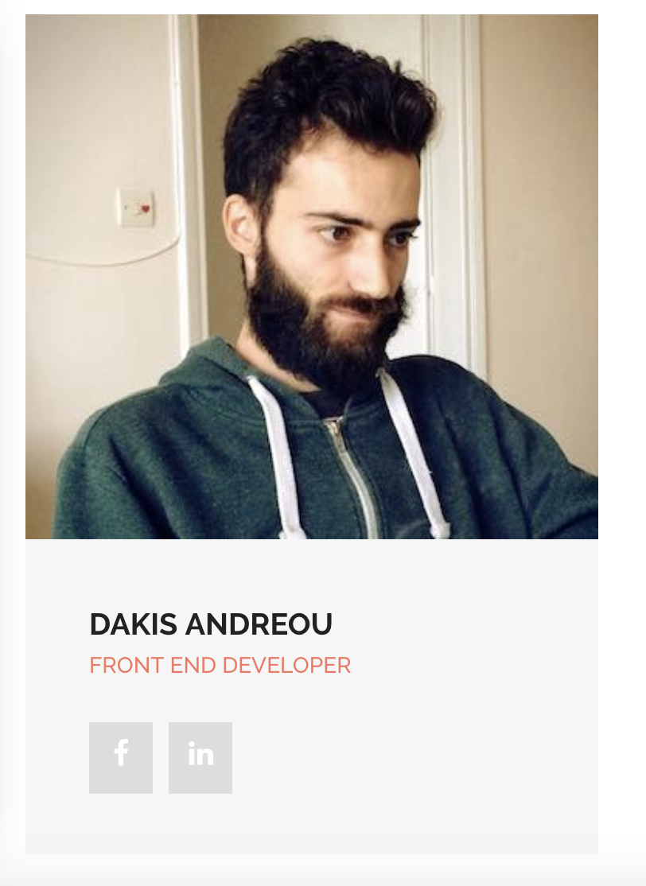
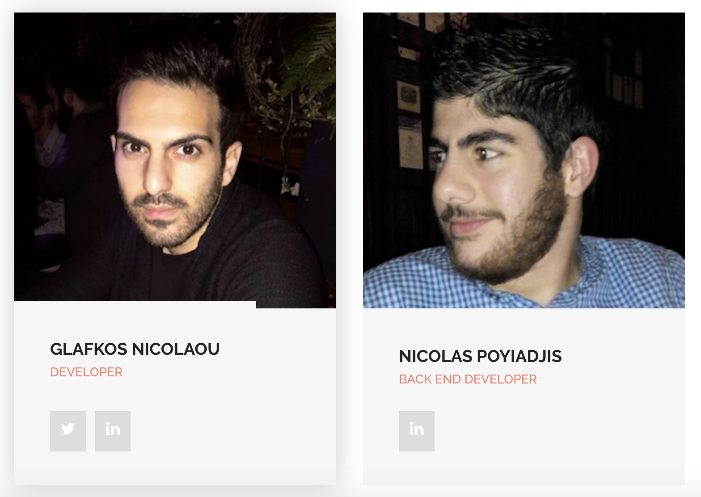
Ideas2life Team @hackathoncy #insurtech
http://ideas2life.com.cy

Slide 3


Ideas2life
Founded 2012
Projects:
atyourservice.com.cy
foody.com.cy

Slide 4
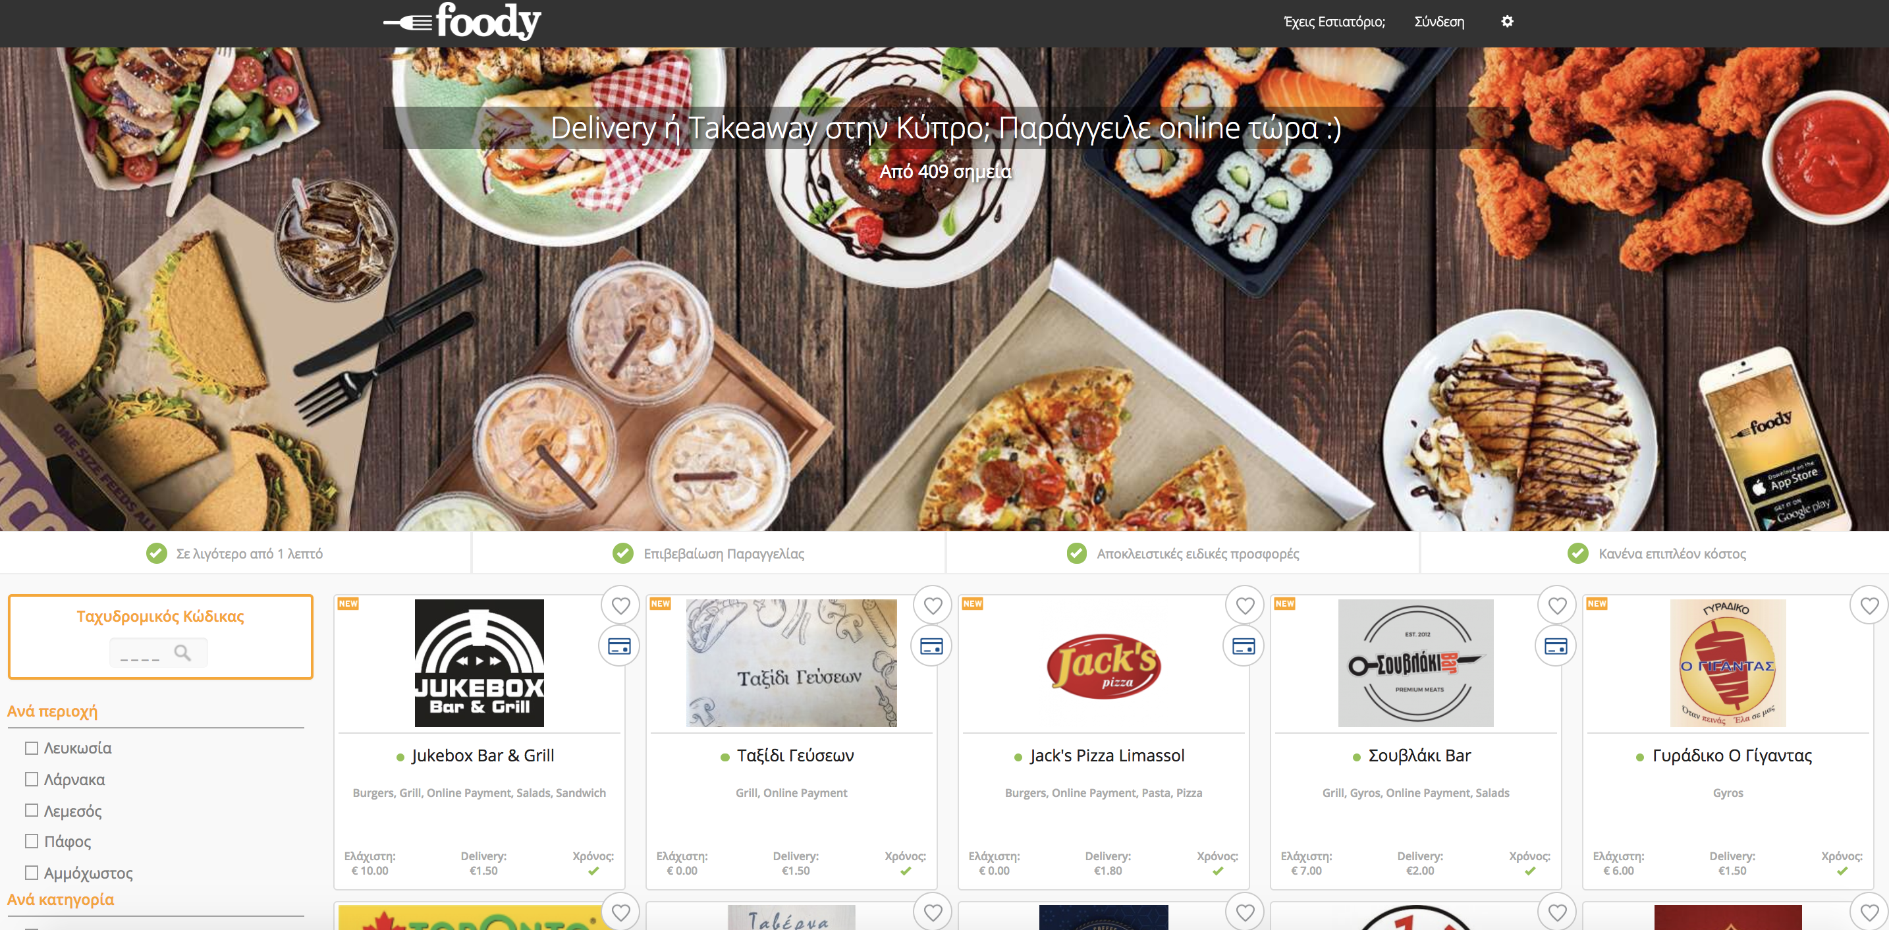
foody.com.cy
Launched Sep 2015
561K orders
8.2M euro in orders
410 restaurants
15% month-to-month Growth

Slide 5
Problem
Insurance of Delivery Vehicles & Drivers of new Restaurants
What is the risk factor for a new restaurant?
Solution
A parametric prediction tool
monthly Sales Volume (euro), Orders Volume(#), Distance (km)
Risk Indicator – accidents & stolen vehicles
Fraudulent Claims – spotlight suspicious claims

Slide 6
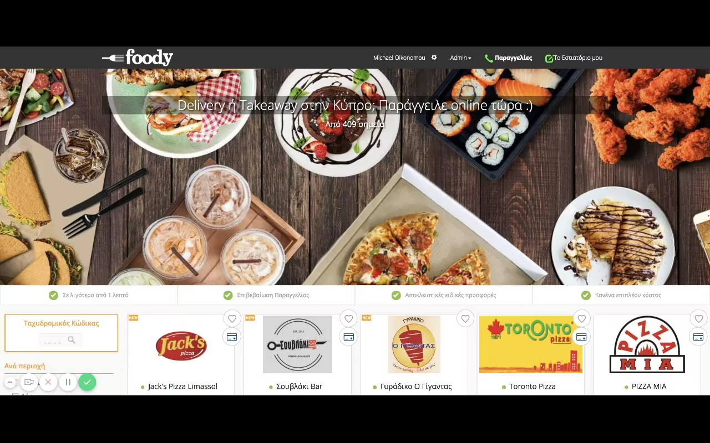

Slide 7
Next steps
Enrich with following data:
Accidents from motorbikes per Post Code
Thefts of motorbikes per Post Code
Number of claims per restaurant per post code
Challenges
Restaurant Delivery now is not insured (!?)
Not a good market fit with Insurance Industry so far ?

